Slide 1
Machine Learning - Introduction
Exploratory Data Analysis

Slide 2
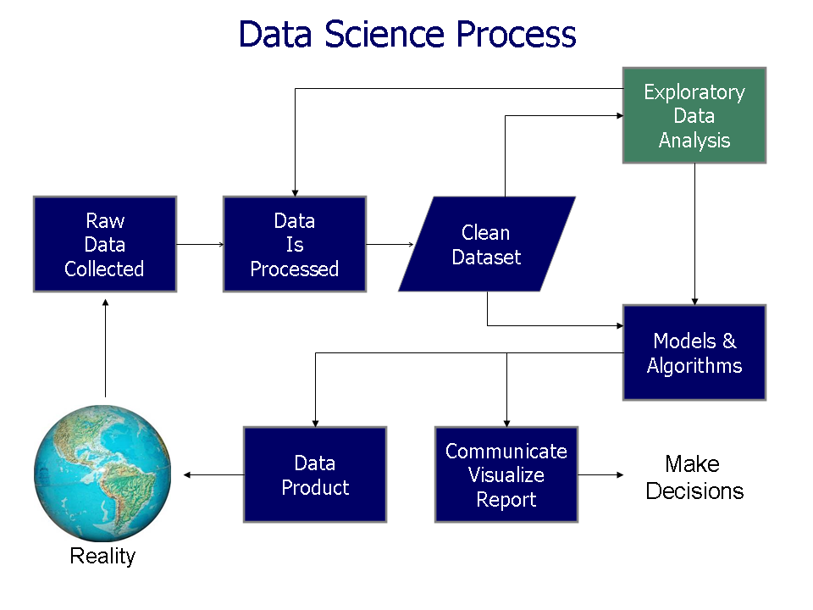
Data Science Process
Source: Wikipedia

Slide 3
Exploratory Data Analysis
EDA is an approach to analyzing data sets to summarize their main characteristics, often with visual methods

Slide 4
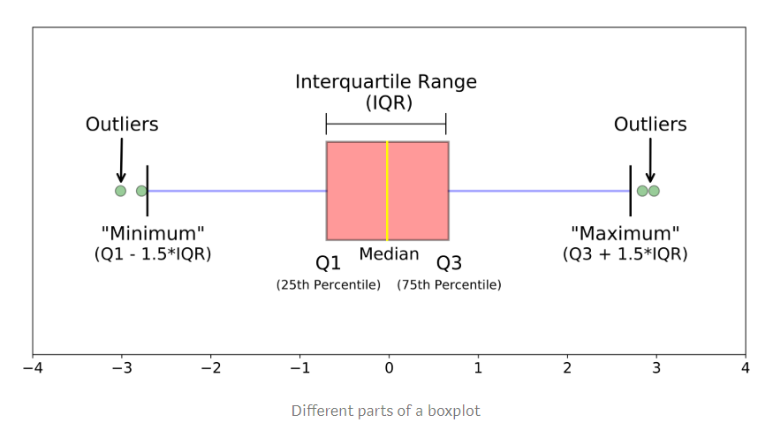
Boxplots
https://towardsdatascience.com/understanding-boxplots-5e2df7bcbd51

Slide 5
Quartile, IQR, Whisker, Outlier
Boxplots are a standardized way of displaying the distribution of data based on a five number summary (“minimum”, first quartile (Q1), median, third quartile (Q3), and “maximum”)
median (Q2/50th Percentile): the middle value of the dataset. (Be careful: a median separates the higher half from the lowe half of the dataset)
first quartile (Q1/25th Percentile): the middle number between the smallest number (not the “minimum”) and the median of the dataset.
third quartile (Q3/75th Percentile): the middle value between the median and the highest value (not the “maximum”) of the dataset.
interquartile range (IQR): 25th to the 75th percentile.
whiskers (shown in blue)
outliers (shown as green circles)
“maximum”: Q3 + 1.5*IQR
“minimum”: Q1 -1.5*IQR
https://towardsdatascience.com/understanding-boxplots-5e2df7bcbd51

